Slide 1
ATAI
Advanced Techniqueof Artificial Intelligence
ATAI
ChongqingUniversity _{AdvancedTechniqueof}
of Technology Artificial Intelligence
Chongqing University of
Technology
Chongqing University ^{ATAI}
_{of Technology} Advanced Techniqueof
Artificial Intelligence
Chongqing University of Technology
Chongqing University of Technology
Tora: Trajectory-oriented Diffusion Transformer for Video Generation
Code: projectpage: https://ali-videoai.github.io/tora video/.
2025.3.31 •ChongQing
—— CVPR 2025
Reported by Ling Tan
1

Slide 2
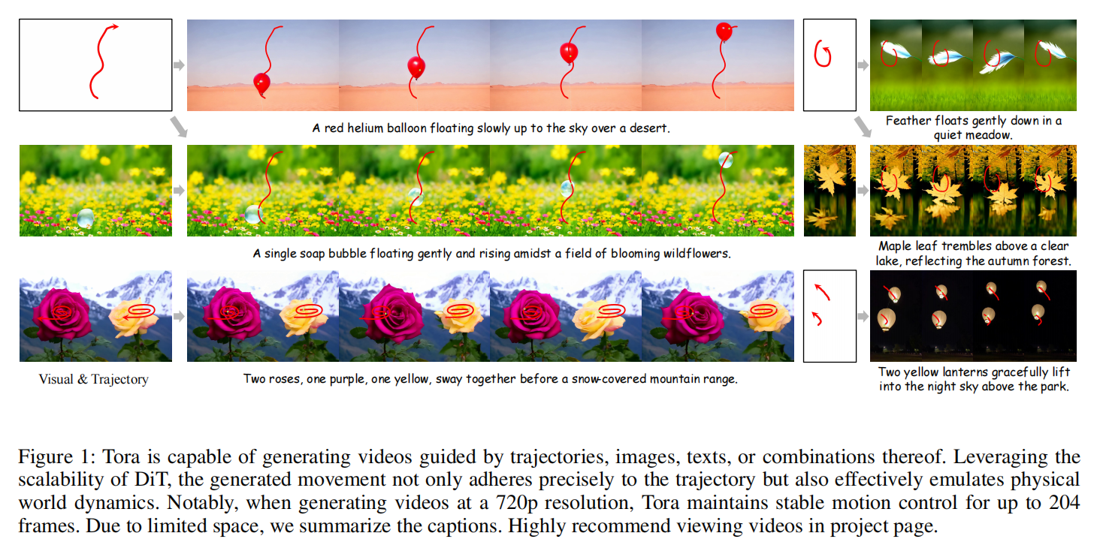
ATAI
AdvancedTechniqueof
Artificial Intelligence
ATAI
ChongqingUniversity _{AdvancedTechniqueof}
of Technology Artificial Intelligence
ChongqingUniversity of Technology
Motivation

Slide 3
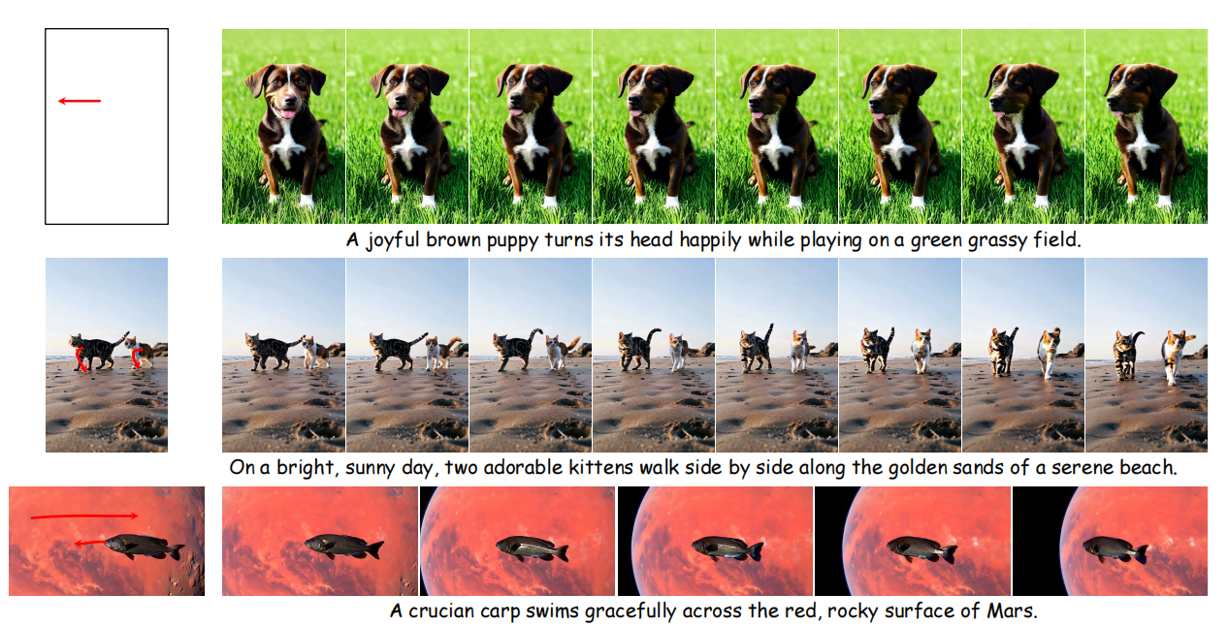
ATAI
AdvancedTechniqueof
Artificial Intelligence
ATAI
ChongqingUniversity _{AdvancedTechniqueof}
of Technology Artificial Intelligence
ChongqingUniversity of Technology
Motivation

Slide 4
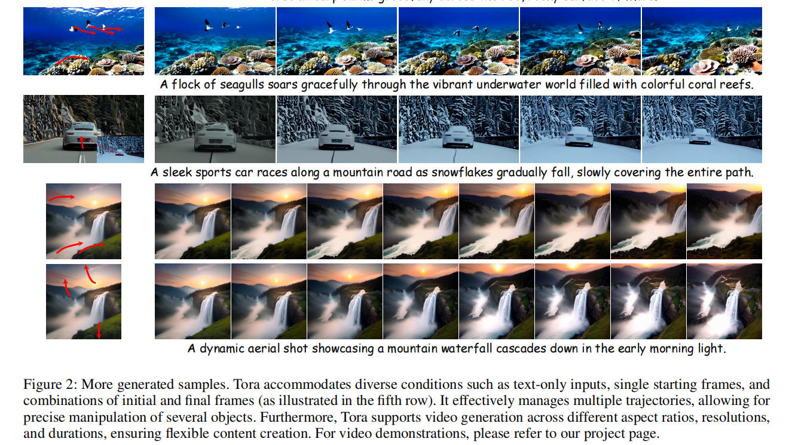
ATAI
AdvancedTechniqueof
Artificial Intelligence
ATAI
ChongqingUniversity _{AdvancedTechniqueof}
of Technology Artificial Intelligence
ChongqingUniversity of Technology
Motivation

Slide 5
ATAI
AdvancedTechniqueof
Artificial Intelligence
ATAI
ChongqingUniversity _{AdvancedTechniqueof}
of Technology Artificial Intelligence
ChongqingUniversity of Technology
Motivation

Slide 6
ATAI
AdvancedTechniqueof
Artificial Intelligence
ATAI
ChongqingUniversity _{AdvancedTechniqueof}
of Technology Artificial Intelligence
ChongqingUniversity of Technology
Motivation
U-Net methods are restricted to generating videos of only 16 frames at a fixed, lower resolution.This limitation hinders the smooth portrayal of motion, particularly during significant positional shifts in the provided trajectory, leading to distortion and unnatural movements,such as parallel drifting, which diverge from real-world dynamics.
Notes:
主要关注合成有限时间的视频，通常大约两秒，并被限制在固定的分辨率和高宽比。但它仅限于以固定的、较低的分辨率生成16帧的视频。这种限制阻碍了对运动的平滑描述，特别是在所提供的轨迹中发生显著的位置变化时，导致扭曲和非自然的运动，如平行漂移，这偏离了现实世界的动力学，因此，迫切需要一种模型，能够产生更长的视频，具有鲁棒的运动控制和详细的物理表示。

Slide 7
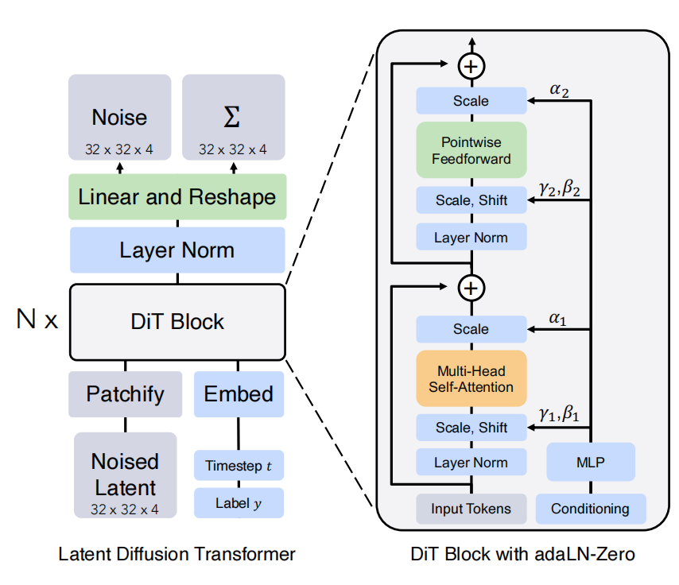
ATAI
AdvancedTechniqueof
Artificial Intelligence
ATAI
ChongqingUniversity _{AdvancedTechniqueof}
of Technology Artificial Intelligence
ChongqingUniversity of Technology
Motivation

Slide 8
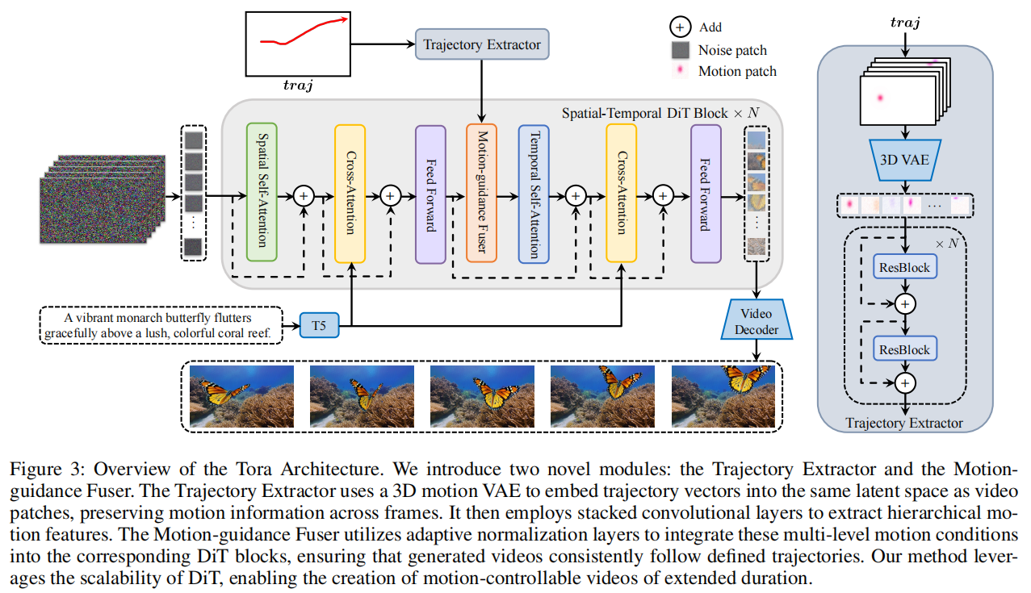
ChongqingUniversity of Technology
ATAI
AdvancedTechniqueof
Artificial Intelligence
ATAI
ChongqingUniversity _{AdvancedTechniqueof}
of Technology Artificial Intelligence
Overview

Slide 9
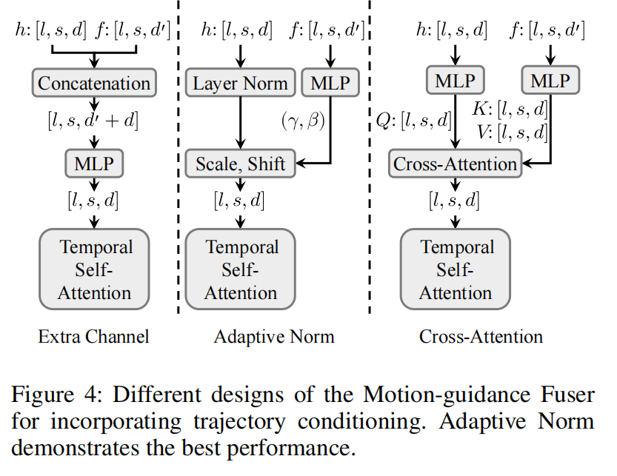
ChongqingUniversity of Technology
ATAI
AdvancedTechniqueof
Artificial Intelligence
ATAI
ChongqingUniversity _{AdvancedTechniqueof}
of Technology Artificial Intelligence
Overview

Slide 10
ChongqingUniversity of Technology
ATAI
AdvancedTechniqueof
Artificial Intelligence
ATAI
ChongqingUniversity _{AdvancedTechniqueof}
of Technology Artificial Intelligence
Method
Preliminary

Slide 11
ATAI
AdvancedTechniqueof
Artificial Intelligence
ATAI
ChongqingUniversity _{AdvancedTechniqueof}
of Technology Artificial Intelligence
ChongqingUniversity of Technology
Experiments

Slide 12
ATAI
AdvancedTechniqueof
Artificial Intelligence
ATAI
ChongqingUniversity _{AdvancedTechniqueof}
of Technology Artificial Intelligence
ChongqingUniversity of Technology
Experiments
Notes:
FVD最初用于衡量生成视频与真实视频分布之间的相似性。CLIP Similarity（CLIPSIM）是由 Wu et al. (2021) 提出的指标，利用 CLIP 模型（Contrastive Language-Image Pretraining）衡量生成内容与文本提示之间的语义一致性。Trajectory Error（TrajError）是 Tora 特有的指标，用于评估生成视频中物体运动轨迹与预定义轨迹之间的符合程度。它衡量运动控制的精确性。
随着帧数的增加，U-Net方法表现出显著的偏差，导致错位错误，导致变形、运动模糊，或物体在以后的序列中消失

Slide 13
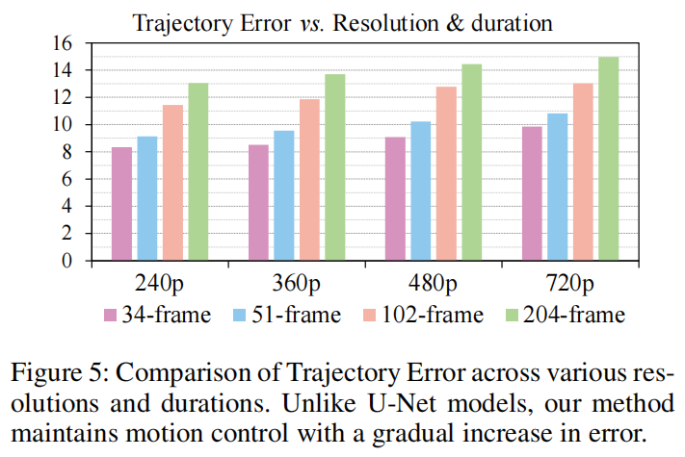
ATAI
AdvancedTechniqueof
Artificial Intelligence
ATAI
ChongqingUniversity _{AdvancedTechniqueof}
of Technology Artificial Intelligence
ChongqingUniversity of Technology
Experiments
Notes:
Tora 能够在更高分辨率和更长时长下保持较好的运动控制能力，误差增长是可控的

Slide 14
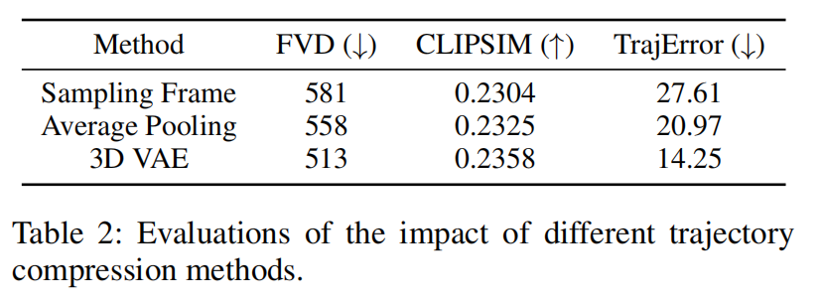
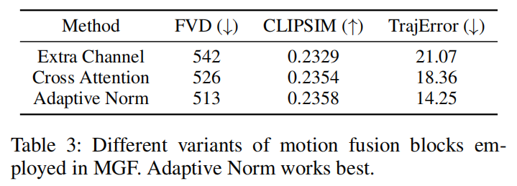
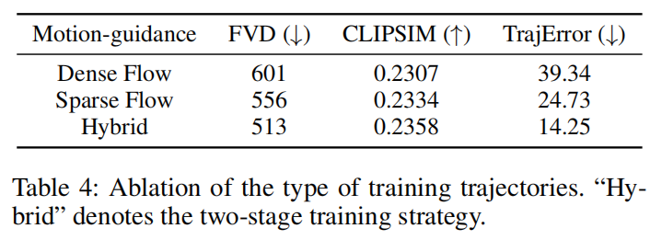
ATAI
AdvancedTechniqueof
Artificial Intelligence
ATAI
ChongqingUniversity _{AdvancedTechniqueof}
of Technology Artificial Intelligence
ChongqingUniversity of Technology
Experiments
Notes:
4帧采一帧，在快速运动或遮挡（occlusions）情况下，光流估计可能出错，导致轨迹信息丢失。对连续帧（例如，每 4 帧）应用平均池化；抹平了轨迹的方向和幅度（direction and magnitude），丢失了关键运动细节。

Slide 15
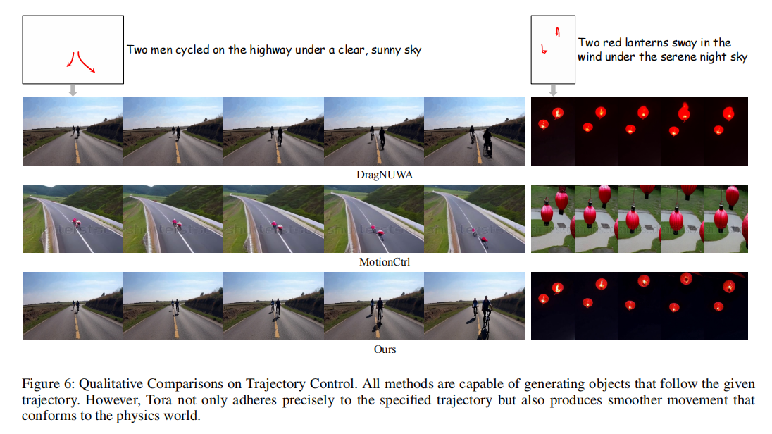
ATAI
AdvancedTechniqueof
Artificial Intelligence
ATAI
ChongqingUniversity _{AdvancedTechniqueof}
of Technology Artificial Intelligence
ChongqingUniversity of Technology
Experiments
Notes:
此外，DragNUWA和MotionCtrl在视频的结尾都遇到了明显的运动模糊。此外，MotionCtrl在骑行过程中引入了意想不到的摄像机运动，尽管没有任何预期的摄像机运动条件。

Slide 16
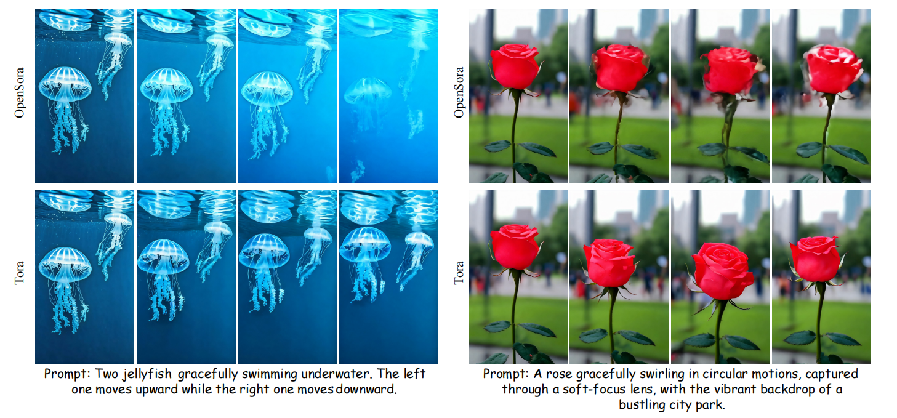
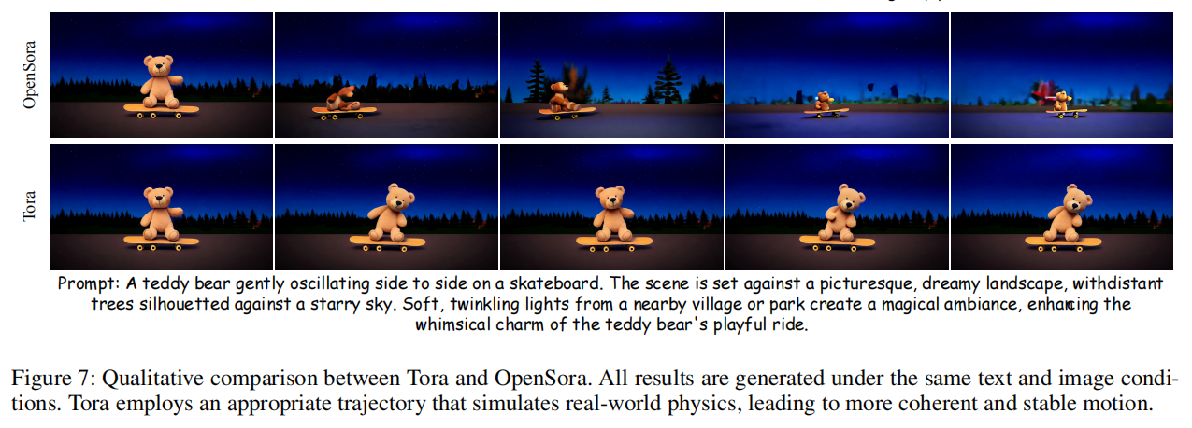
ATAI
AdvancedTechniqueof
Artificial Intelligence
ATAI
ChongqingUniversity _{AdvancedTechniqueof}
of Technology Artificial Intelligence
ChongqingUniversity of Technology
Experiments
Notes:
比如多个物体同时移动、摆动或盘旋。这通常会导致不连贯或扭曲的前景物体。当管理多个实体的运动时，比如一对水母——一个向上移动，另一个向下移动，OpenSora显示出明显的闪烁，这凸显了它在处理复杂运动方面的局限性。在泰迪熊在滑板上左右摆动或玫瑰做圆周运动的情况下，仅依赖文本指令的OpenSora，表现出明显的物体变形。

Slide 17
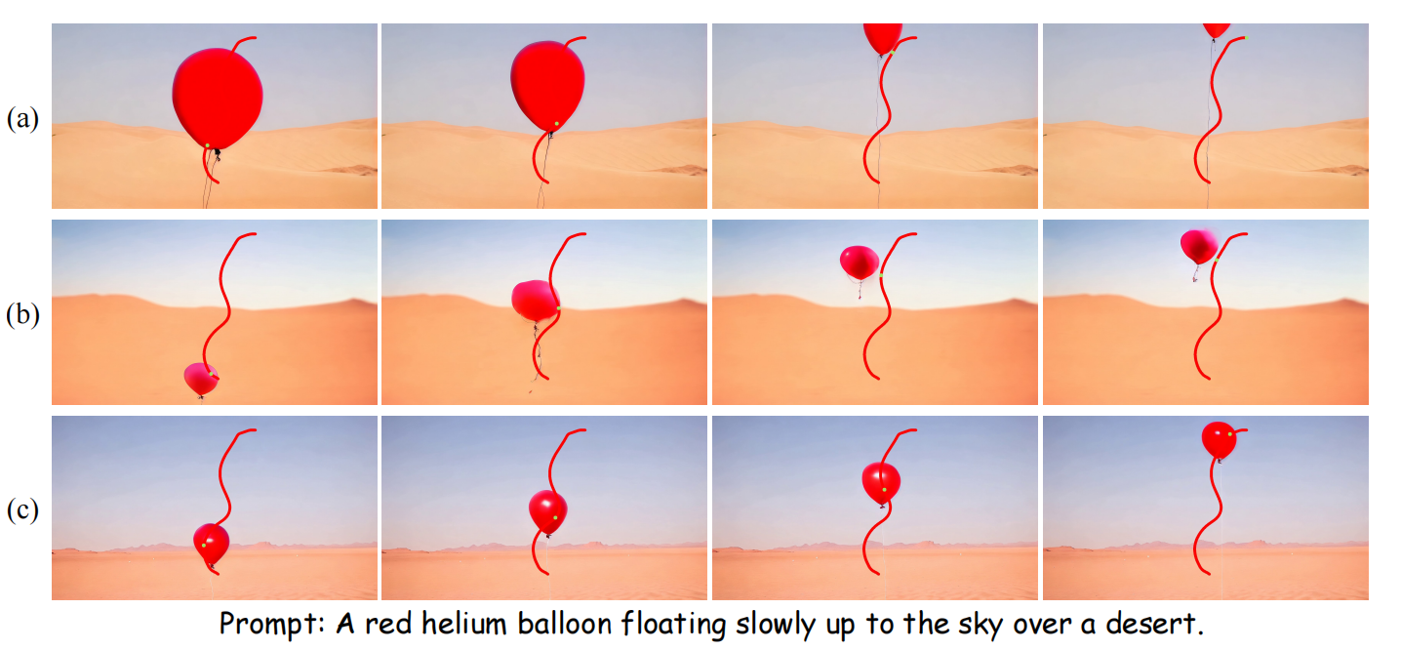
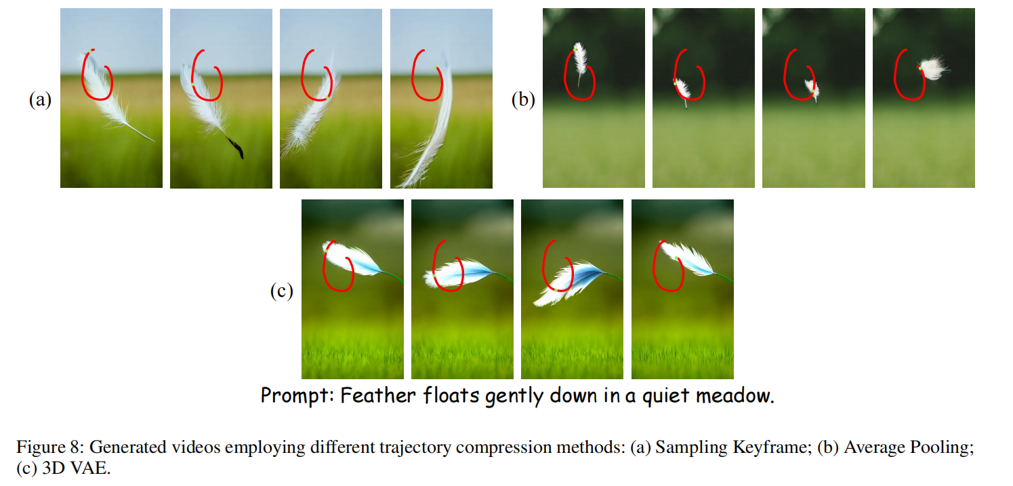
ATAI
AdvancedTechniqueof
Artificial Intelligence
ATAI
ChongqingUniversity _{AdvancedTechniqueof}
of Technology Artificial Intelligence
ChongqingUniversity of Technology
Experiments
Notes:
在关键帧采样中，虽然它成功地捕捉到了基本的运动，但它经常导致视频补丁和运动补丁之间的错位，特别是在快速运动序列中。这种错位阻碍了生成的物体准确地跟踪它们的轨迹，对视觉流动性和整体质量产生了负面影响。另一方面，平均池化平滑了微小的变化，从而产生更一致的运动表示。然而，在复杂的轨迹中，如连续帧方向不一致的s型转弯，这种方法可能会引入伪影，因为光流的物理相关性降低。

Slide 18
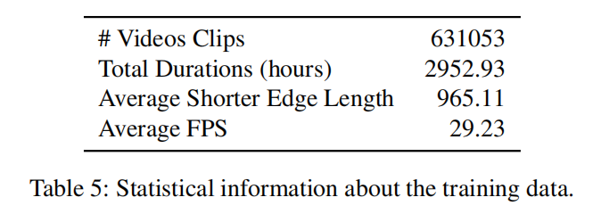
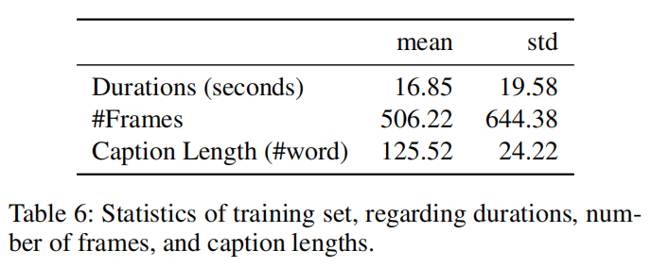
ATAI
AdvancedTechniqueof
Artificial Intelligence
ATAI
ChongqingUniversity _{AdvancedTechniqueof}
of Technology Artificial Intelligence
ChongqingUniversity of Technology
Experiments

Slide 19
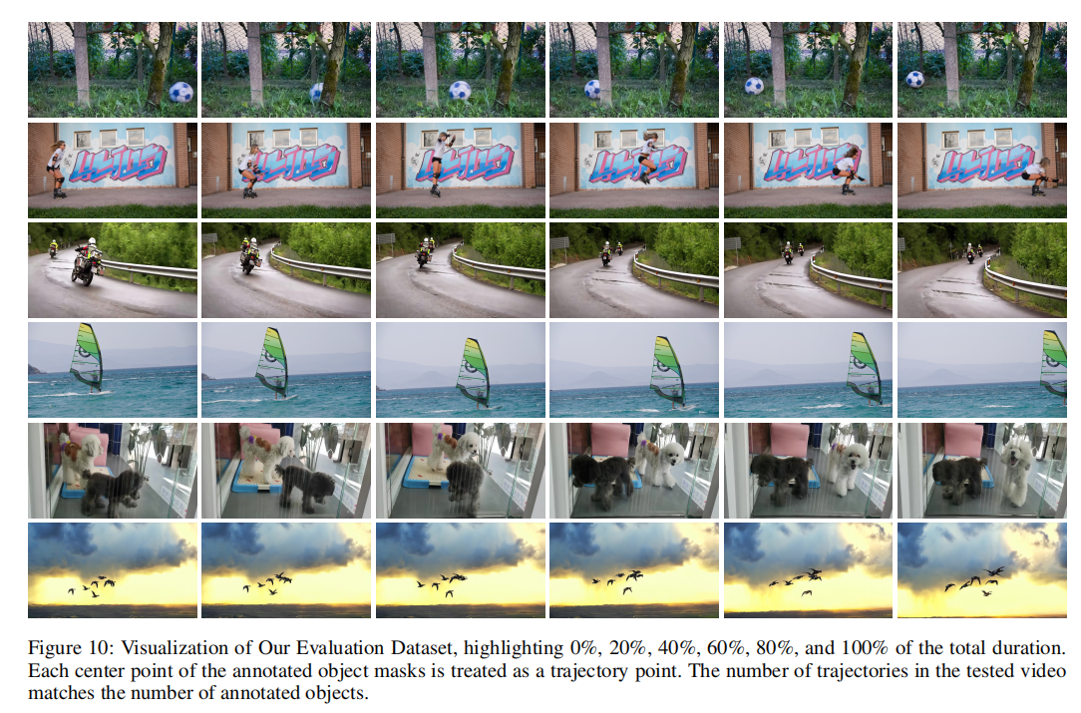
ATAI
AdvancedTechniqueof
Artificial Intelligence
ATAI
ChongqingUniversity _{AdvancedTechniqueof}
of Technology Artificial Intelligence
ChongqingUniversity of Technology
Experiments

Slide 20
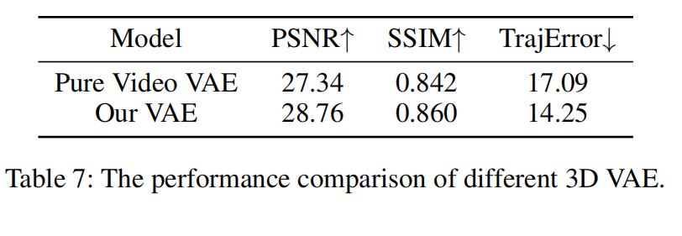
ATAI
AdvancedTechniqueof
Artificial Intelligence
ATAI
ChongqingUniversity _{AdvancedTechniqueof}
of Technology Artificial Intelligence
ChongqingUniversity of Technology
Experiments

Slide 21
ChongqingUniversity of Technology
ATAI
AdvancedTechniqueof
Artificial Intelligence
ATAI
ChongqingUniversity _{AdvancedTechniqueof}
of Technology Artificial Intelligence
Thanks!

